Slide 1


Understanding Patient and Health Professional Perspectives to Improve Access to Exercise Services
Briana Clifford. PhD, Exercise Physiologist
b.clifford@unsw.edu.au
@bri__clifford

Slide 2
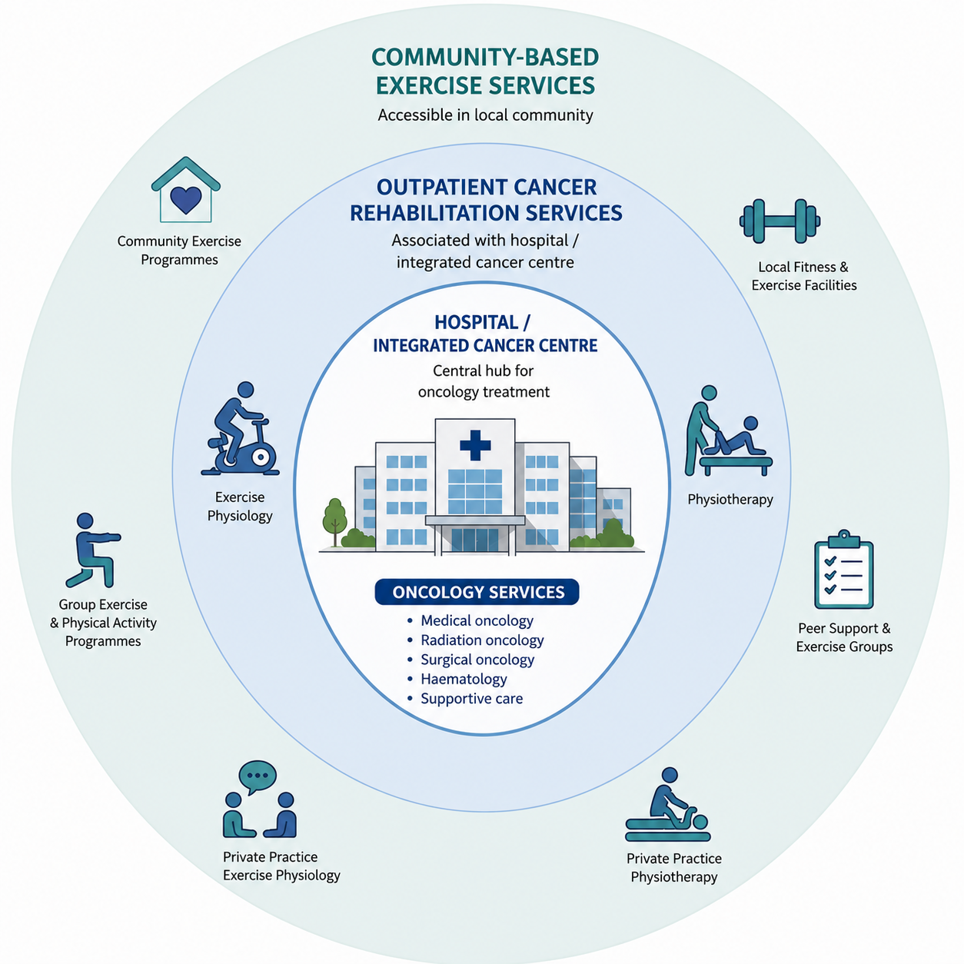


Australian healthcare context
Chronic Conditions Management Plan (CCMD): 5x Allied health sessions per year (referral from their general practitioner)
Notes:
Context for how exercise services are currently delivered in Aus healthcare system:
Most oncology care happens in hospitals or integrated cancer centres.
Increasingly these large centres have in/patient or outpatient exercise or rehab services. BUT typically these are limited in number, usually geographically concentrated in metro areas and are typically for a short period of time.
Once people complete their treatment ongoing exercise is expected to occur in the community.
Australia has a well established workforce of allied health professionals, who have the potential to support these patients in the community but the transition between hospital and community care is poorly coordinated leading to low engagement with community services.

Slide 3
Bridging the gap between the hospital and the community
How do we create systems that make exercise possible after a cancer diagnosis?
Hospital Based Oncology Care
Outpatient Exercise Sciences
Community Based Services
Aim: Capture and evaluate the unique experiences of people living with and beyond cancer, oncology professionals and exercise professionals, regarding exercise engagement, referral and service provision in cancer care

Slide 4
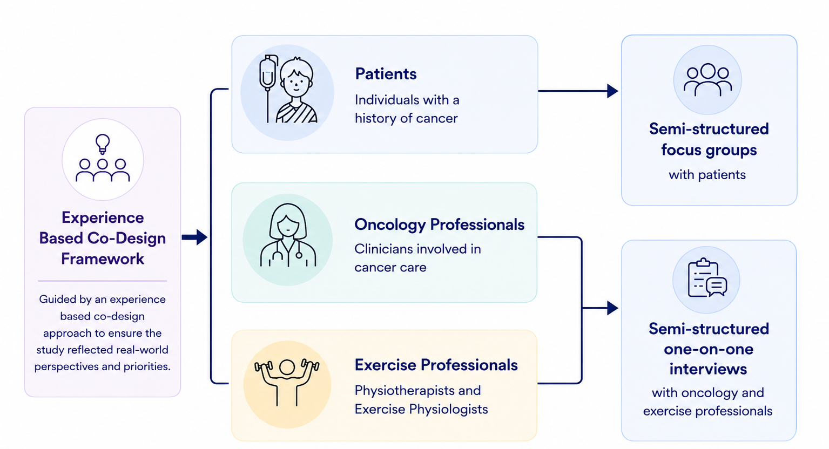
Analysis: Data was line-by-line coded in Nvivo and thematically analysed

Slide 5
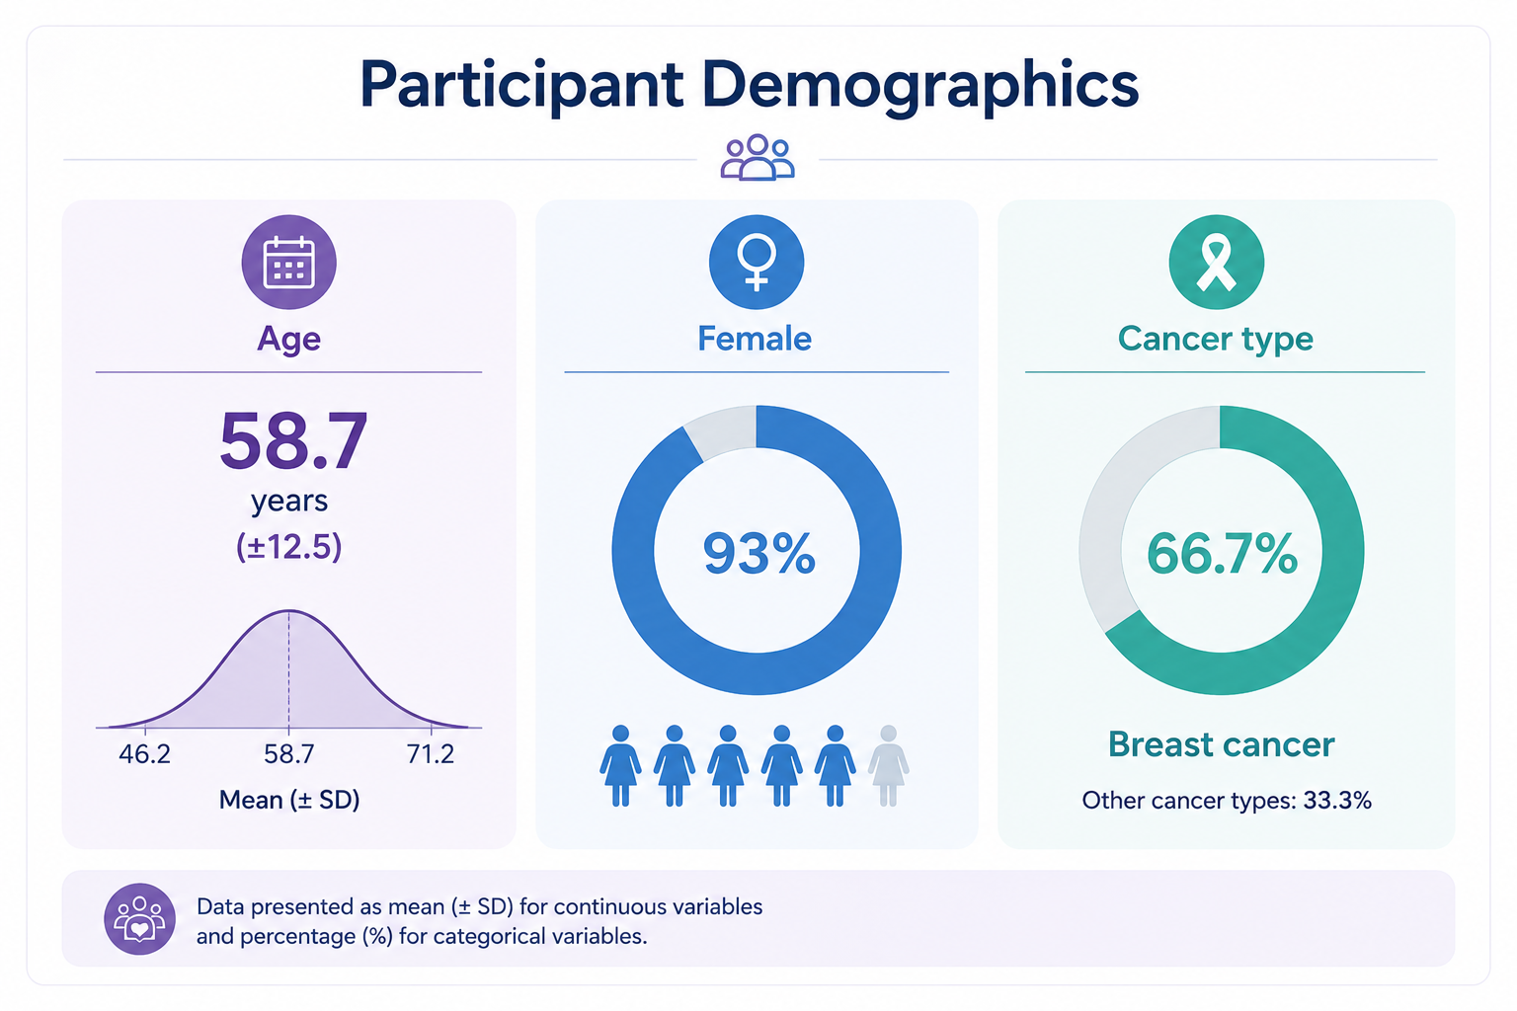
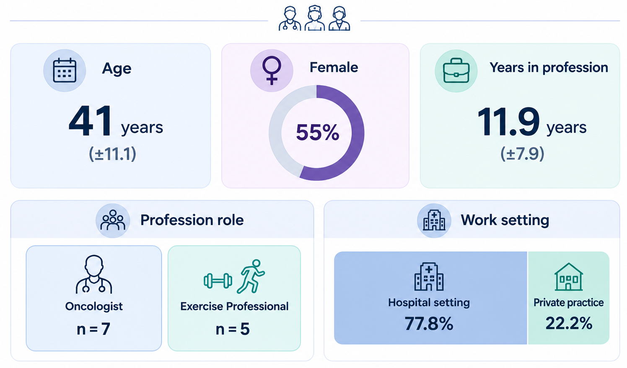
Patients (n=15)
Healthcare professionals
Analysis: Data was inductively line-by-line coded in Nvivo and thematically analysed

Slide 6
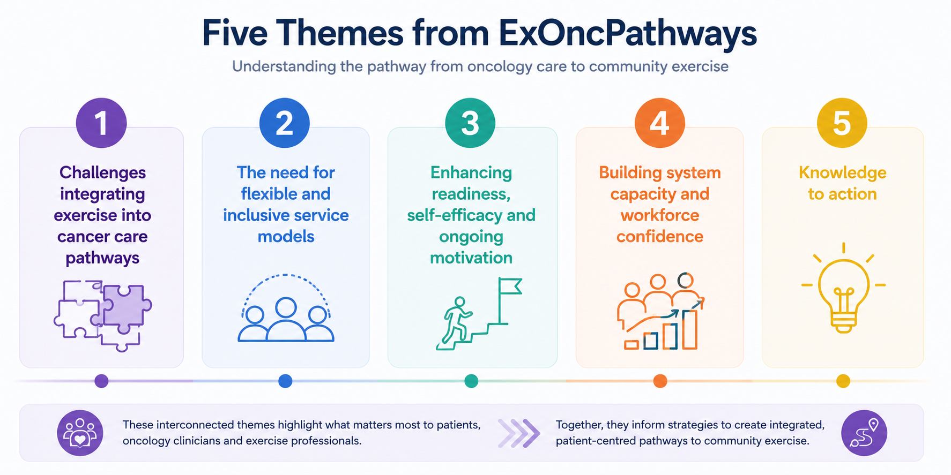

Slide 7
Subtheme | Descriptor | Quotes
Exercise timing - Best practice not reflected in standard care | Variable timing of exercise advice/ referral Patients reported wanting referral info and advice earlier EPs highlighted missed opportunities when patients are not referred | “the first times that we speak about exercise is probably in the context of when a patient's more or less settled into the groove of, you know, treatment” - Oncology clinician “it was always the five years, 10 years post. We didn't get any early intervention in” – Exercise professional
Coordination and continuity | Communication between primary care, patient and oncology clinician Trust in continuity of care when transitioning to the community setting | “It's one of those things that probably falls through the cracks and you know, the cancer people think the GP's telling you and the GP thinks [your oncologist] is telling you” - Patient “I guess the biggest issue for us is... having them be medically stable. To then refer to a private service” – Exercise professional
Resourcing limitations | Gold standard models of care not sustainable under current funding models | “Funding is our is our huge issue and at the moment you know we have waiting lists…because the importance we put on it, we actually fundraise another three days a week” – Oncology clinician

Slide 8
Subtheme | Descriptor | Quote
Service availability and variability | Patients have variable service options because of the hospital they received treatment These services are at capacity and wait lists are long Variability in cost | “I'm not a local. There is a big exercise service available at Concord... but I'm not in the catchment so... I think there is a problem when someone isn’t local, we get left out of the loop” – Patient
Adaptable and safe modes of program delivery | Hybrid models of delivery are critical from the perspective of patients and clinicians Requires triaging for more complex cases | “If a person is particularly vulnerable with complex pain, you know and I'm still getting to know them... I prefer one on one in that situation”. – Oncology clinician
Eligibility, suitability and cost | Clinicians consider cost and need when making referral decisions. | “cost is, you know, something that again I ask - is private possible?” – Oncology Clinician “if it's a limited service, it's almost biased, but you’re going to pick someone that who is going to gain the most from it and ready to make the change or ready to receive more information” – Oncology Clinician
Considering culture and context | Cultural context influences referral practices. Language barriers and cultural differences | “there's phone interpreters… generally speaking, you know with the different language comes the different culture.” – Oncology Clinician

Slide 9
Subtheme | Description | Quotes
Clinician communication and influence | Clincian’s advice and beliefs about exercise influenced whether patients took up their referral recommendations | “[My oncologist] was like, kind of don't worry about it until I finished treatment” – Patient “If they can see that it's something that's I that I believe in and I've highlighted and it's sort of sitting right next to their chair in the clinic room.” – Oncology clinician
Building confidence and competence | Referrals to services and exercise professionals needed at times to build patient confidence | “I want to exercise. But I'm frightened of doing damage” – Patient “I sort of didn't feel confident doing the exercises on my own” – Patient

Slide 10
Subtheme | Description | Quotes
Clinician Confidence in their role | Clinicians' confidence in their role regarding exercise. | “I wouldn't know... apart from seeing what was done in the respiratory wards many years ago, so I think that that's that's I think the challenge there” – Oncology clinician
Building community workforce capacity | Having trusted exercise professionals in the community with cancer expertise | “Once they finish with us, they have nowhere to go” - Exercise Professional
Linking oncology with primary/ community care | Not aware of community services Highlighted a need for referral resources or checklist | “I don't really know where to send them to apart from just telling them that they could exercise.”- Oncology clinician “Something like a repository or a web page with programs, eligibility and then links to, you know, enrollment information, costs, locations” – Oncology clincian

Slide 11
Improving information flow and visibility of resources and services.
→ Access to service mapping and service availability and referral resources
Services and referral pathways need to be designed to meet the needs of culturally and linguistically diverse (CALD) communities
→ Cultural care coordinators
Strengthening collaborative networks across care settings to improve community workforce capacity

Slide 12





Acknowledgments
The patients and clinician participants
SESLHD - Prince of Wales Hospital, Cancer Survivorship Centre
Dr Monica Tang
School of Health Sciences, UNSW
Ms Eliza Macdonald
Mr Bradley Cullen
Dr Carolina Sandler
Professor David Simar
Behavioural Sciences Unit, Kids Cancer Centre
Dr Christina Signorelli
SWSLHD –Liverpool Hospital, OASIS (Oncology Alliance for the Science of Integrative Survivorship) Research Centre
Professor Eng Siew Koh

