Slide 1




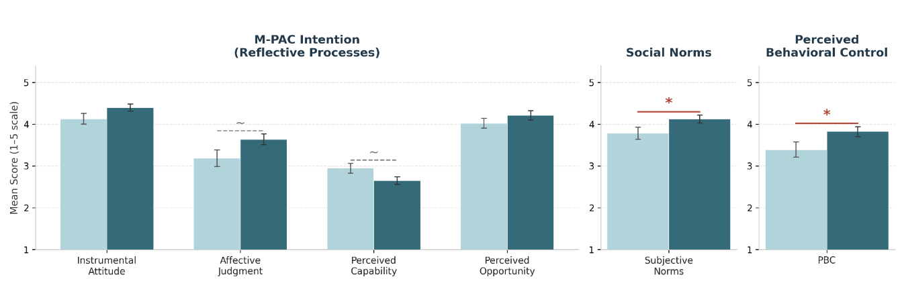
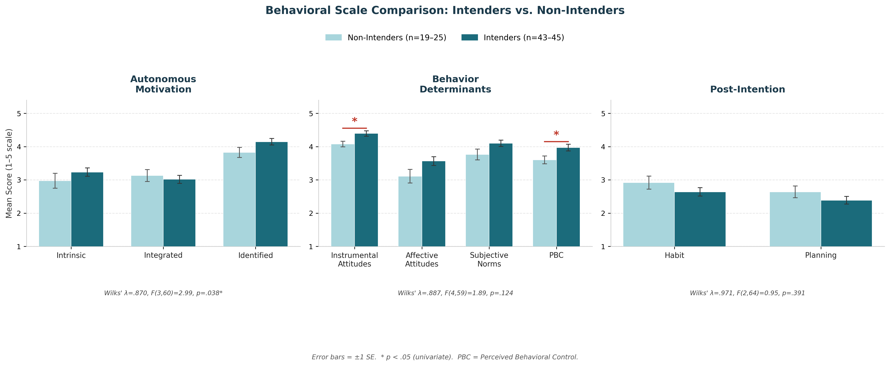
Understanding barriers to exercise participation in those living with metastatic breast cancer: exploratory analysis of the EMBody trial
Tarah J. Ballinger³, Donya Nemati², Niraj Shah³, Danielle Halsey³, Navin Kaushal¹
¹ Indiana University School of Health and Human Sciences ²The Ohio State University College of Nursing, ³Indiana University School of Medicine
Contact: tarahb@iu.edu; NCT05468034
EXTENDING SURVIVORSHIP AND LIFESTYLE INTERVENTIONS TO MBC SURVIVORS
Prospective trials support the positive impact of exercise on cardiorespiratory fitness (CRF), physical functioning, and muscle mass in patients with early-stage breast cancer.
CRF is a predictor of worse cancer- specific survival, and there is a high prevalence of physical impairment and sarcopenia in patients with MBC, both associated with worse quality of life and survival.
Patients with indolent MBC are well-positioned to participate in and benefit from an exercise program.
MBC has heterogeneous trajectories; prior work suggesting limited feasibility or efficacy of exercise has been primarily in patients receiving chemotherapy or who have more rapidly progressing disease.
Kin et al, JCO Oncology Practice, 2021
The EMBody trial is a randomized-controlled trial of 16 weeks of remote aerobic and resistance exercise in women living with indolent MBC (stable disease > 12 months) with a primary endpoint of CRF.
Given the unique and understudied relationship of this population with exercise, we sought to determine barriers and predictors of participation in women offered exercise for MBC as part of the EMBody trial.
METHODS
Eligibility
Metastatic breast cancer with no progression in last 12 months
ECOG performance status 0-2
Ability to march in place for 30 seconds
Currently not meeting physical activity guidelines (<150 min/wk MVPA)
Eligible participants who agreed to participate (intenders) were compared to those who declined participation but still agreed to complete a baseline survey (non-intenders) using t-test or MANOVA analysis (p<0.05 significant).
Survey components included:
  International Physical Activity Questionnaire (IPAQ)
  PROMIS 29 v2.1 physical function, anxiety, depression, pain interference, and fatigue
  Validated response scales for constructs of reflective processes in the M-PAC model, social norms, and perceived behavioral control
Eligible MBC survivors
N = 80
Consented Intenders
N = 43
Declined, non-Intenders
N = 37
Completed opt out survey
N = 27
RESULTS: Intenders vs. Non-Intenders
CONCLUSIONS
  No differences in age, race, ethnicity, martial status, income, education level, or health insurance status between the groups.
Brief motivational interviewing may improve upfront uptake in this population, specifically targeting self-efficacy and social reinforcement, rather than exercise benefits alone.
Qualitative work will help further refine the intervention and its scalability.
This study highlights what can be learned from the other column of the CONSORT diagram that ‘opts out’ of participation in exercise research or programming.
PROMIS domain | Intenders N = 41 | Non-Intenders N = 26 | T-test p value
Anxiety | 49.4 (6.7) | 49.3 (7.8) | t=-0.05, p=0.961
Depression | 47.4 (7.4) | 47.7 (7.4) | t=0.21, p=0.834
Fatigue | 54.9 (7.9) | 51.2 (9.4) | t=-1.73, p=0.089
Pain interference | 57.1 (8.4) | 51.0 (10.2) | t=-2.67, p=0.010 *
Physical function | 45.6 (8.6) | 43.0 (7.5) | t=-1.27, p=0.208
*Participants with missing data are excluded (n=2 intenders and n=1 non-intender)
Non-intenders
Intenders
t = -2.03, p = 0.047
t = -2.03, p = 0.046
Wilks’ λ = 0.764 F(4,61) = 4.72, p = 0.002
PBC = perceived behavioral control
p < 0.05 sig on univariate analysis
Reflective processes for exercise intention differed significantly in intenders vs. non-intenders; however, this is not driven by any one construct. Intenders demonstrated more social reinforcement and perceived behavioral control, which was the most significant construct in predicting intention.
Notes:
BACKGROUND: Patients with metastatic breast cancer (MBC) are often excluded from exercise research and programming, despite potential benefits. Given the unique needs and understudied relationship of this population with exercise, we sought to evaluate barriers to participation in supervised exercise for women with MBC.
METHODS: Eligible patients (n=60) had stable MBC, were not meeting activity guidelines (<150 minutes MVPA/week) and were invited to a 16-week supervised, virtual exercise intervention. Participants who declined (n=17) were “non-intenders,” and those who agreed (n=43) were “intenders.” Both intenders and non-intenders completed questionnaires assessing MVPA (IPAQ), health related quality of life (HRQoL) and subscales of physical function, anxiety, depression, pain interference and fatigue using PROMIS-29 v.2.1. Exercise motivation (values, self-identity and experience), attitudes, social norms, and perceived behavioral control were measured using validated theory-based surveys. Intenders and non-intenders were compared using MANOVA analyses.
RESULTS: Non-intenders and intenders showed no differences in MVPA (p=0.547) or autonomous motivation (p=0.441). Overall HRQoL differed significantly (p=0.015) with intenders reporting higher pain interference compared to non-intenders (p=0.009). Behavioral determinants differed significantly (p=0.012) with intenders reporting higher subjective norms (p=0.013), perceived behavioral control (0.003), and instrumental attitudes toward exercise (p=0.044).
CONCLUSIONS: Those who intended to participate reported worse HRQoL and more pain, but had stronger behavioral determinants. Intenders did not differ from non-intenders in MVPA levels or motivation, but perceived more behavioral control, had more favorable instrumental attitudes toward exercise, and felt stronger social support for exercise. Findings suggest participation was driven by behavioral determinants rather than physical health. This supports a need for programs that focus on improving perceived control through education, removing barriers to participation, and strengthening feelings of social support to improve uptake. A qualitative portion of this work will further inform future study design and exercise programs tailored to fit the needs of women living with MBC.
Interventions aimed at improving recruitment might therefore focus on brief motivational interviewing to address self-efficacy concerns, peer support or social norm messaging ("people like you are doing this"), and emphasizing the practical benefits of exercise in concrete terms — rather than just making the study more accessible or less burdensome, which might be the instinctive approach.

