Slide 1

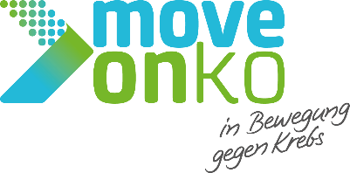

Assessing the Reach of Exercise Therapy Care Pathways
Saskia Blütgen, Katja Krug, Michel Wensing, Juliane Gasde, Joachim Wiskemann, Katharina Graf, Lena Ansmann and on behalf of the MOVE-ONKO Consortium

Slide 2
Background & Methods
The Problem
Despite evidence that exercise therapy improves quality of life and prognosis, it is systematically under-integrated into routine cancer care in Germany.
Aim
To evaluate the implementation of the MOVE-ONKO care pathway across seven CCCs, focusing on the Reach Dimension.
Reach was defined as the number of patients:
accessing cancer centres
enrolling in the exercise therapy pathway
receiving referrals to exercise programmes
Lack of reimbursement structures
Regional inequality and missing program availability
Institutional hurdles for healthcare providers (time, training, knowledge, infrastructure)
Design
The Solution
Two-phase exploratory study, mixed-methods approach.
The MOVE-ONKO Pathway: implementation of a multiprofessional care pathway across seven Comprehensive Cancer Centres (CCCs) in Germany to establish access to exercise therapy.
7 key informants (2022 & 2023), 38 healthcare providers, 353 patient surveys (2024); 17 semi-structured stakeholder interviews.
Descriptive analysis of patient flow data (2023–2024) with SPSS; qualitative content analysis with MAXQDA.
MOVE-ONKO · ISEO 2026 Heidelberg
MOVE-ONKO · ISEO 2026 Heidelberg

Slide 3
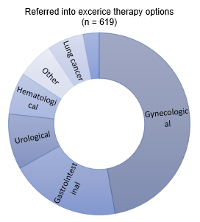
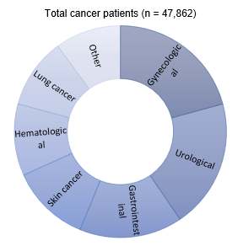
Results & Conclusion
2023 reference year (pre-implementation)
47,862
619
1.3%
cancer in/outpatients
(2023)
referred into
exercise therapy
referral rate
Tumour types (2023)
Referral was not proportional to overall case volume across tumour entities — some entities were markedly over- or underrepresented among the 619 referred patients relative to their share of the 47,862 treated.
2024 MOVE-ONKO baseline enrollment (implementation)
Barriers to participation
353 patients enrolled, with continued concentration in specific diagnoses:
Breast Cancer: 36.3%
Lung Cancer: 8.1%
All other entities: each <5% of baseline enrolment
Exercise therapy reach currently depends on individual effort, not structural capacity and without adequate funding and governmental support, equitable patient access will remain uncertain.
MOVE-ONKO · ISEO 2026 Heidelberg

