Slide 1
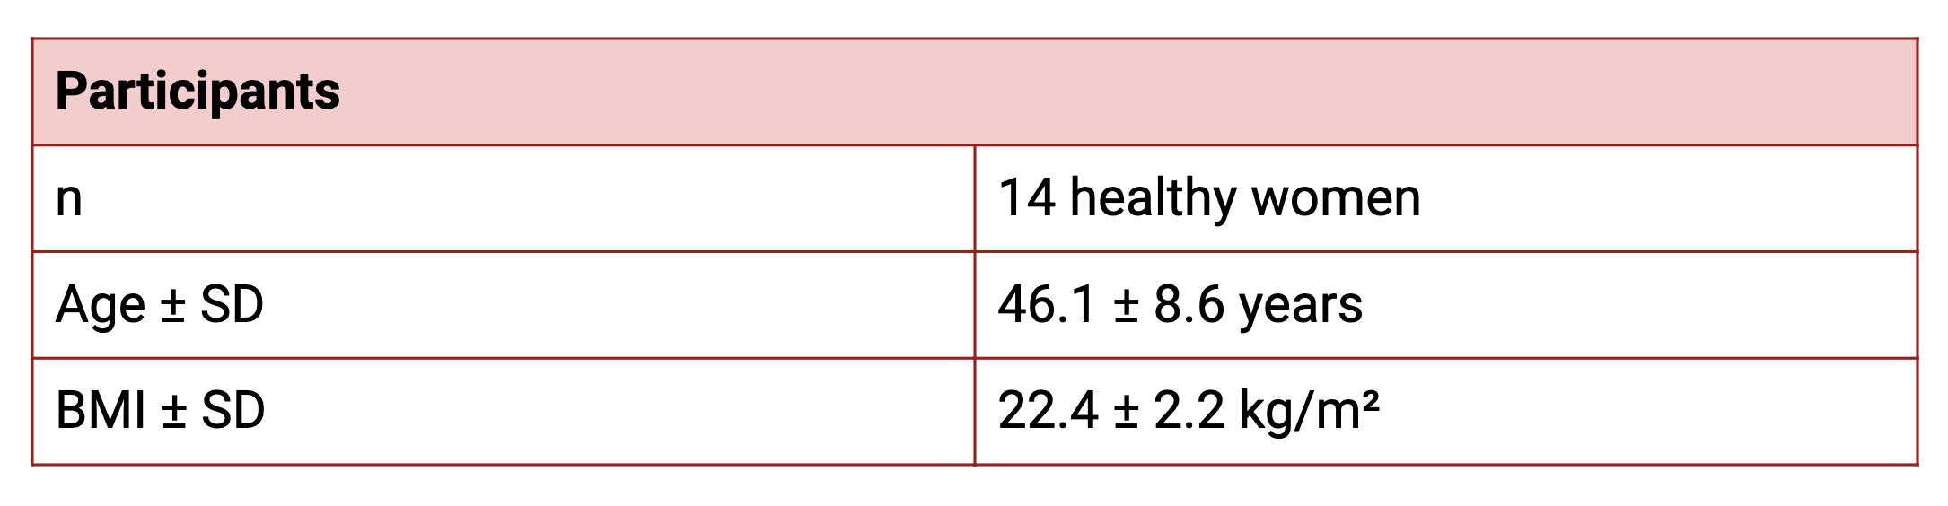
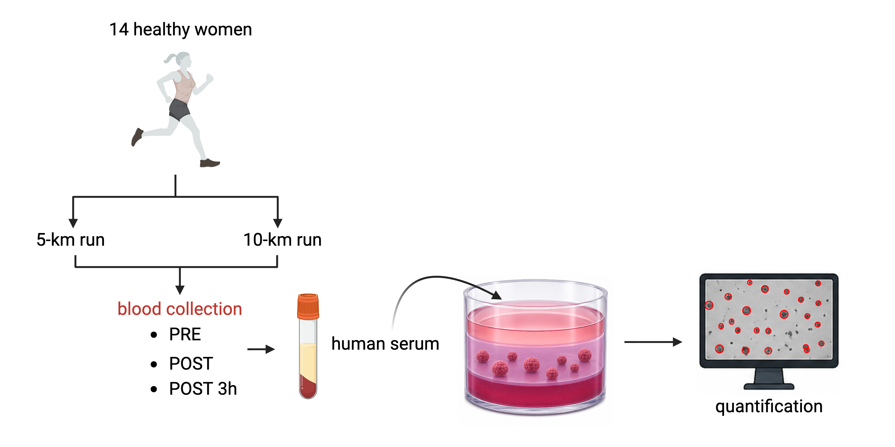
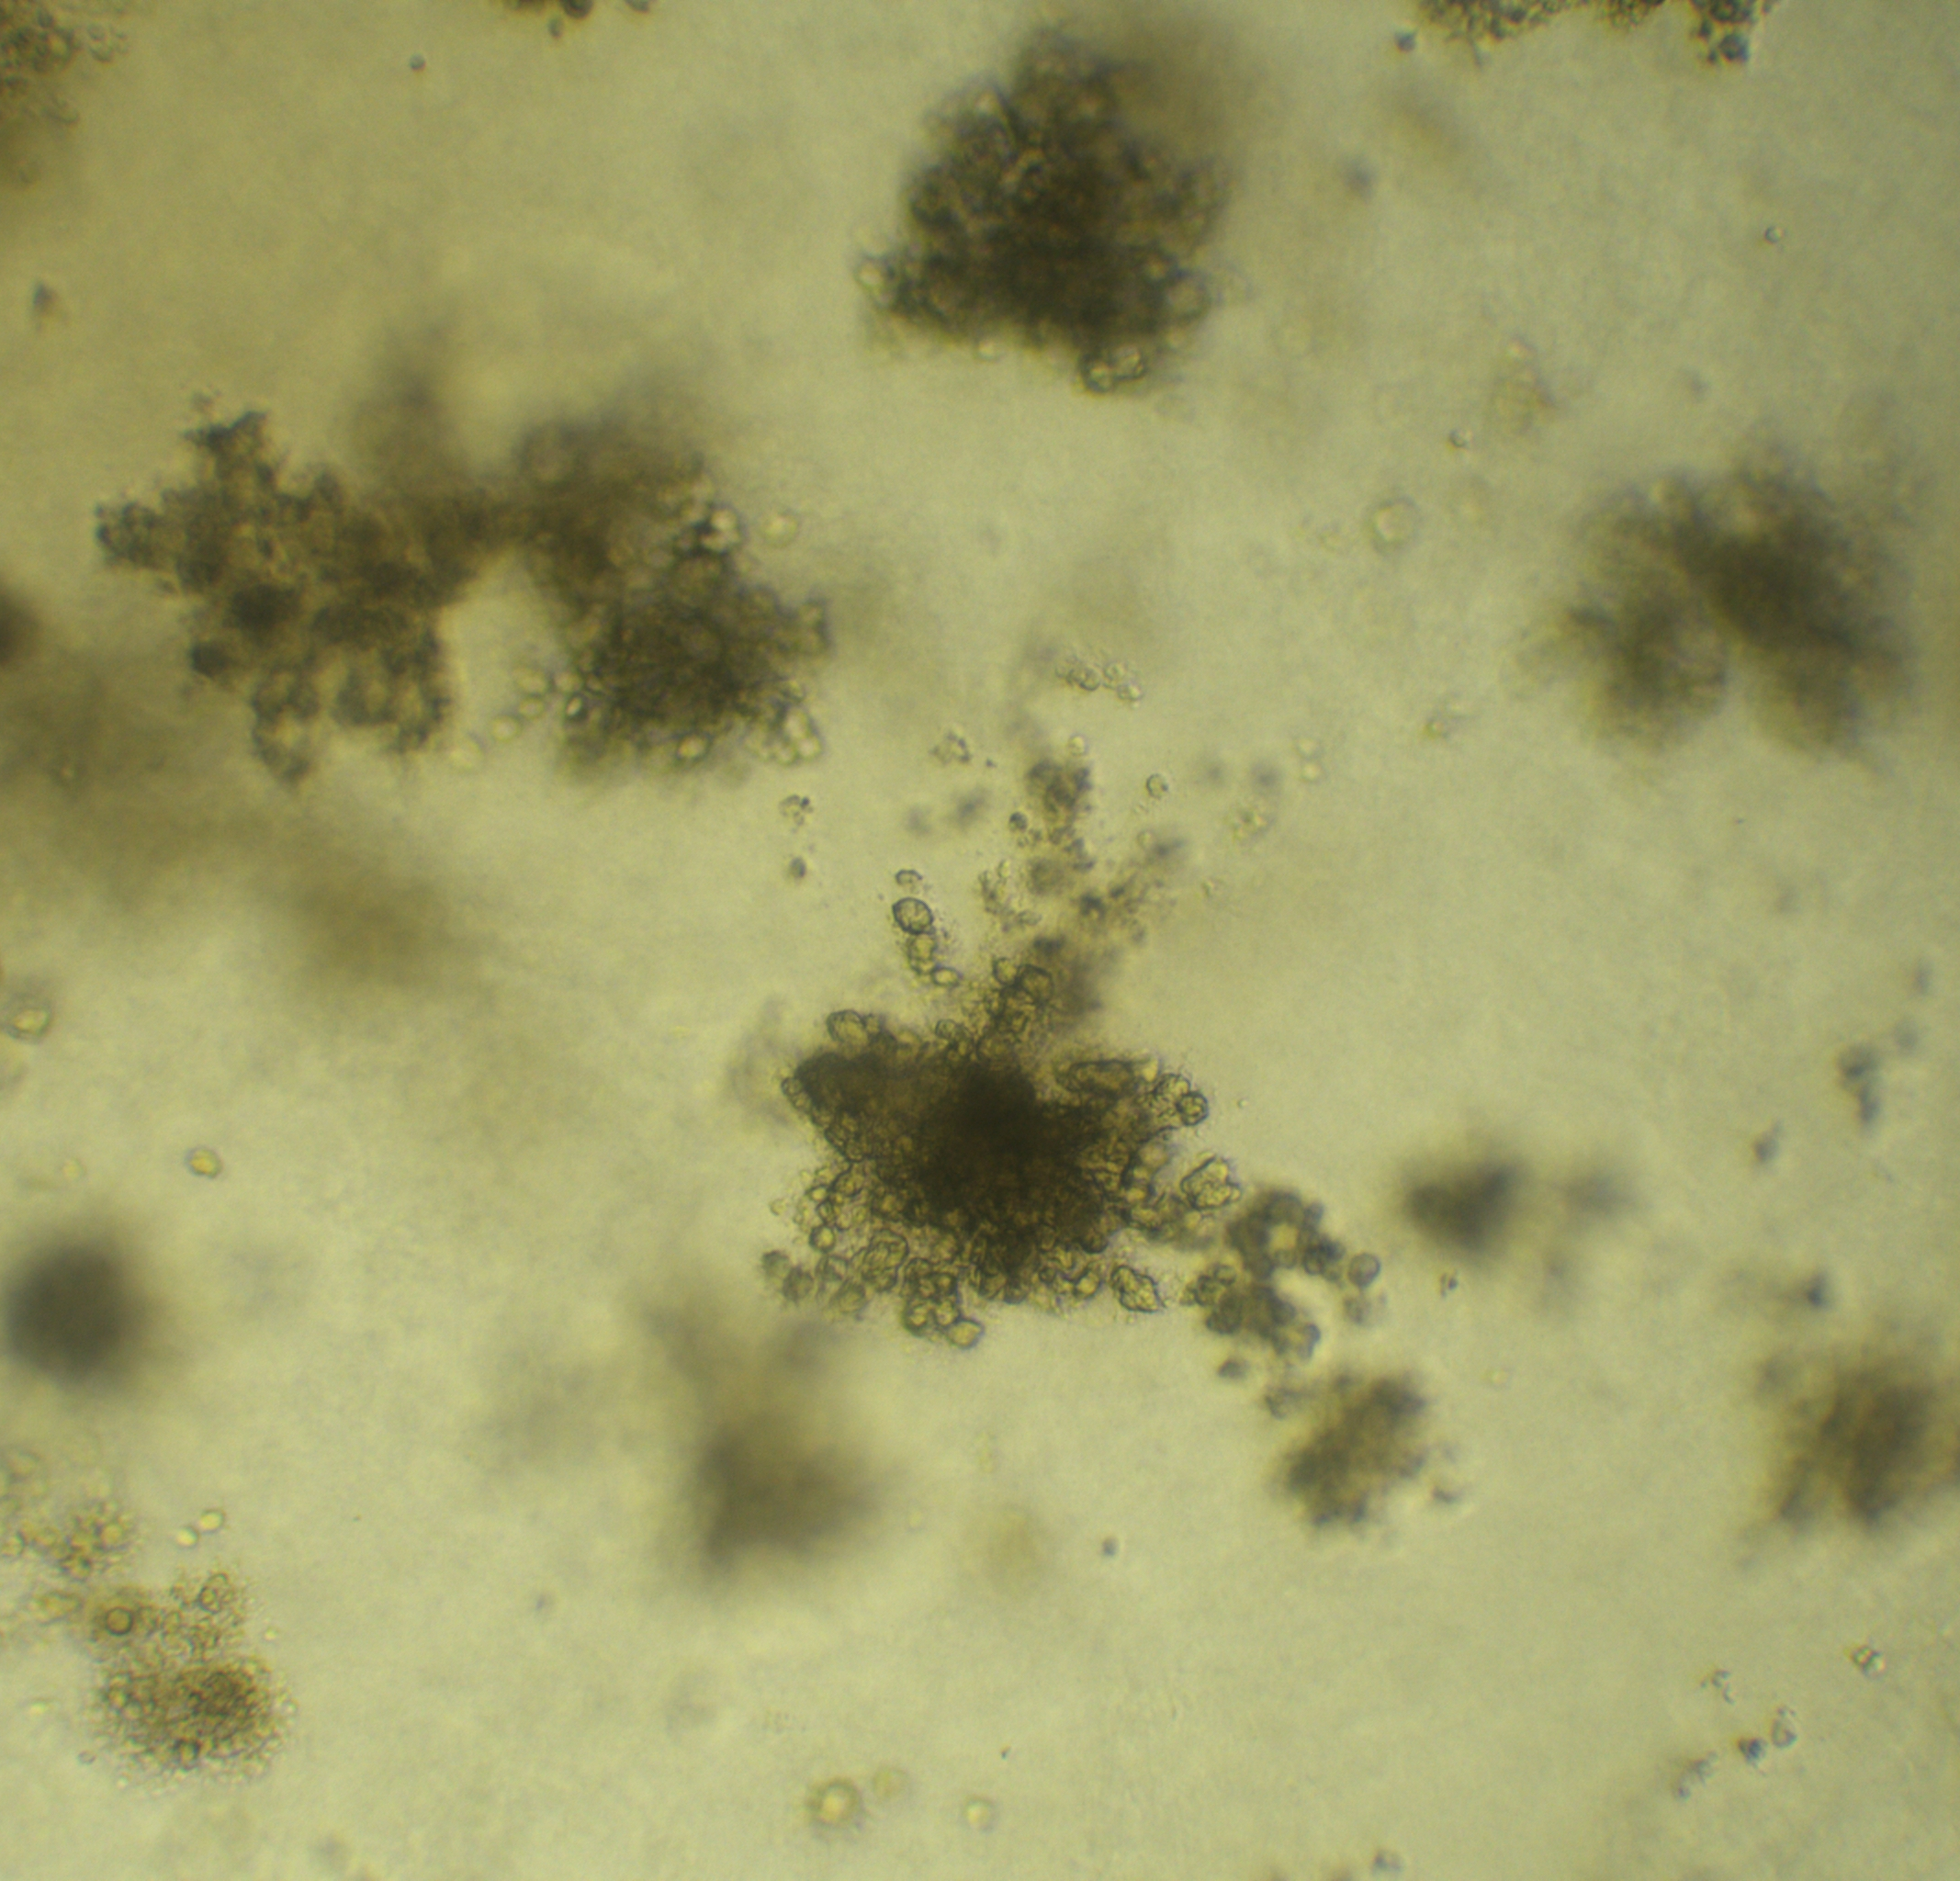
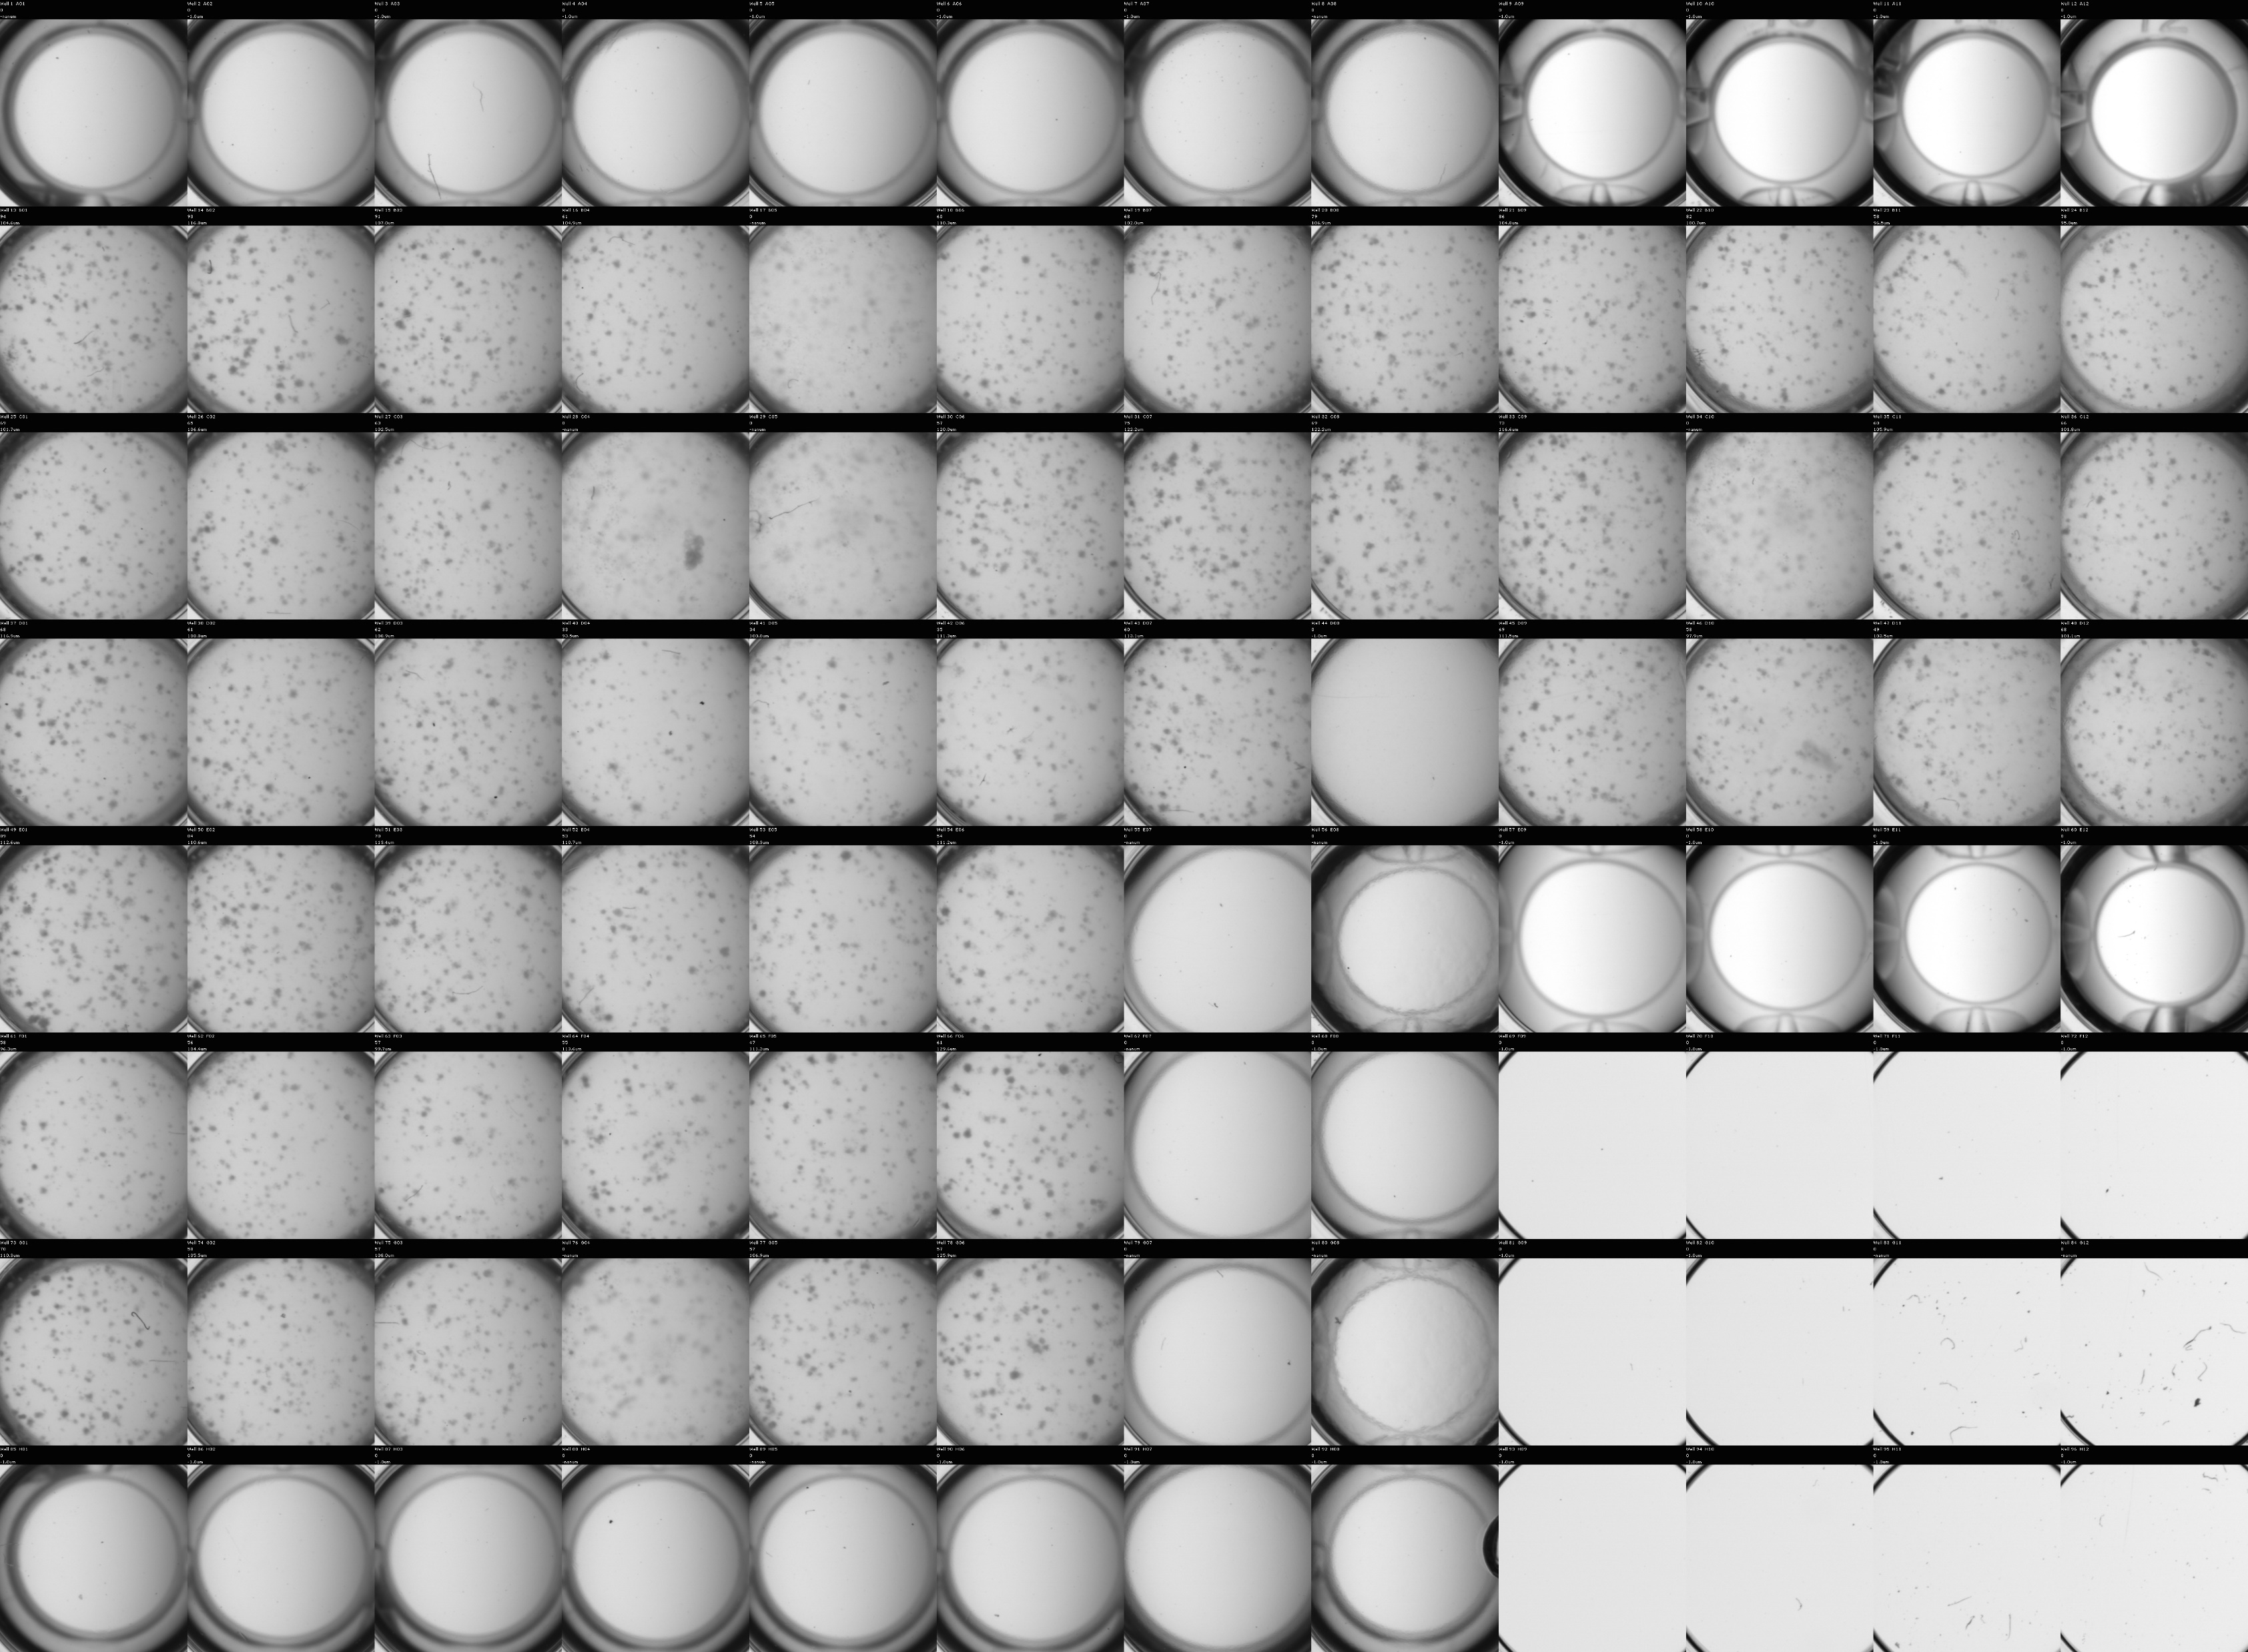
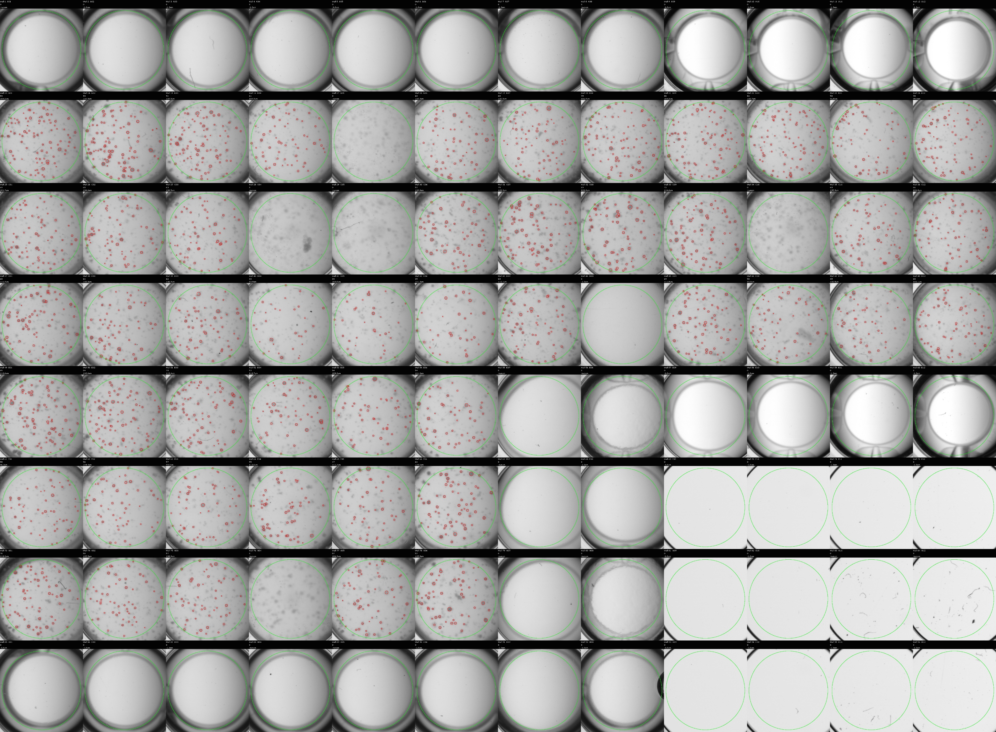


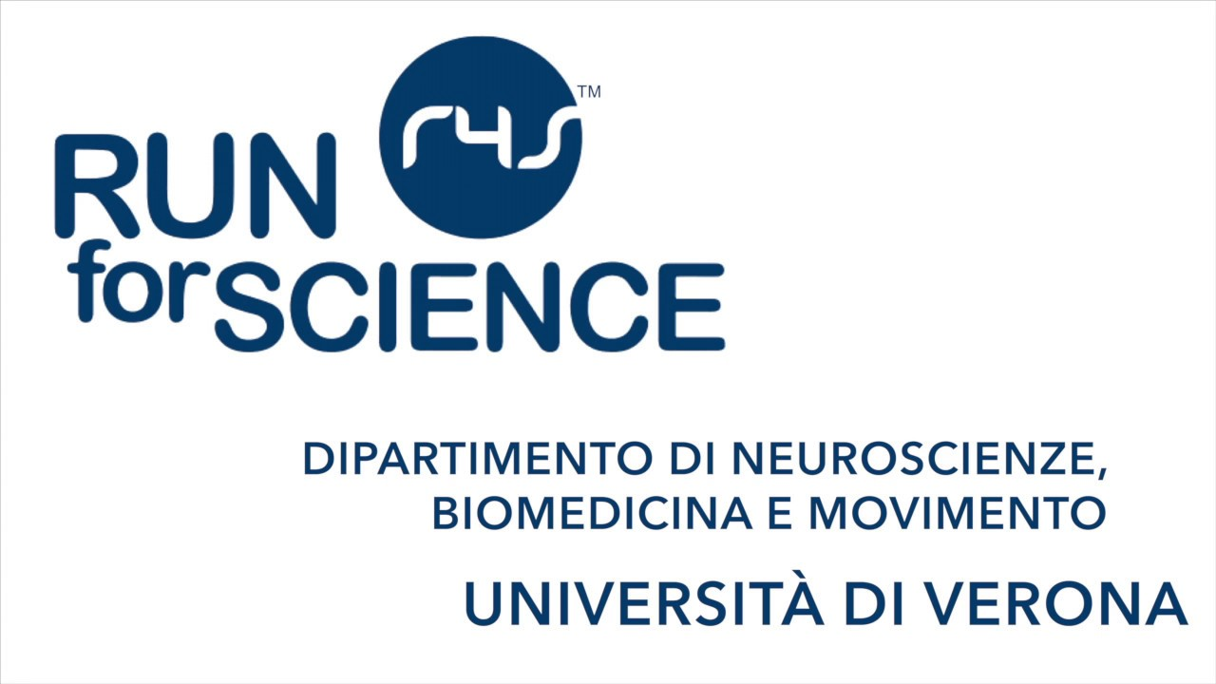
RUNNING SESSION-CONDITIONED HUMAN SERUM REDUCES CANCER CELL SPHEROID FORMATION
Asja Conti¹, Giulia Baldelli¹, Alice Avancini^{2,3}, Lorenzo Budel², Veronica Gentilini¹, Anita Borsati^{2,4}, Christian Ciurnelli², Michele Milella³, Federico Schena², Giorgio Brandi¹, Sara Pilotto³, Cantor Tarperi², Mauro De Santi¹
¹Department of Biomolecular Sciences, University of Urbino Carlo Bo, Italy, ² Department of Neurosciences, Biomedicine and Movement, University of Verona, Verona, Italy,
³ Section of Innovation Biomedicine–Oncology Area, Department of Engineering for Innovation Medicine (DIMI), University of Verona and University and Hospital Trust (AOUI) of Verona, Italy,
⁴ Biomedical, Clinical and Experimental Sciences, Department of Medicine, University of Verona, Verona, Italy
INTRODUCTION
METHODS
Despite advances in diagnosis and treatment improving survival, recurrences are common. Cancer recurrence is frequently associated with tumor dormancy, a reversible state in which residual tumor cells survive and may later reactivate. Three-dimensional cell culture models represent a valuable tool for studying tumor recurrence. Although physical activity is associated with lower cancer recurrence, the underlying biological mechanisms remain poorly understood.
Microscope image at
10X magnification
OBJECTIVE
Soft agar assay
To investigate whether serum collected before and after two acute running sessions (5 km and 10 km) modulates the spheroid-forming capacity of triple-negative breast cancer (TNBC) cells.
TNBC cells were cultured in a 3D soft agar assay and stimulated with sera collected before (PRE), immediately after (POST), and 3 h after (POST-3h) two acute running sessions (5 km and 10 km). After 3 weeks of incubation, spheroid formation was quantified using an automated imaging system (GelCount, Oxford OptronixTM).
RESULTS
Stimulation with POST and POST-3h sera resulted in a significant reduction in TNBC spheroid formation, compared with PRE sera, with the greatest effect observed with POST-3h sera. The latter collected after the 5 km run induced a >5% reduction in spheroid number in all participants (mean reduction 14.2±5.8% ), compared with PRE sera. Comparable effects were observed after the 10 km run (>5% reduction in 13/14 sera) with a mean reduction of 18.0±10.3%. No significant differences were found between the two runs.
-14.2±5.8%
-18.0±10.3%
PRE
POST
POST-3h
PRE
POST
POST-3h
UNPROCESSED
PROCESSED
CONCLUSION
These results align with our previous studies on prostate cancer cells exposed to running-conditioned sera, suggesting that acute exercise may reduce cancer tumorigenic potential, helping explain the link between PA and lower recurrence. Shorter running distances showed comparable effects to longer ones, highlighting practical implications for realworld exercise prescriptions in oncology. Ongoing studies are expanding the cohort by enrolling additional female runners, and the collected sera are currently being tested on lung cancer cell models. These additional data will further clarify the systemic anticancer effects of acute exercise.
CONTACT
Conti Asja
asja.conti@uniurb.it

